Slide 1
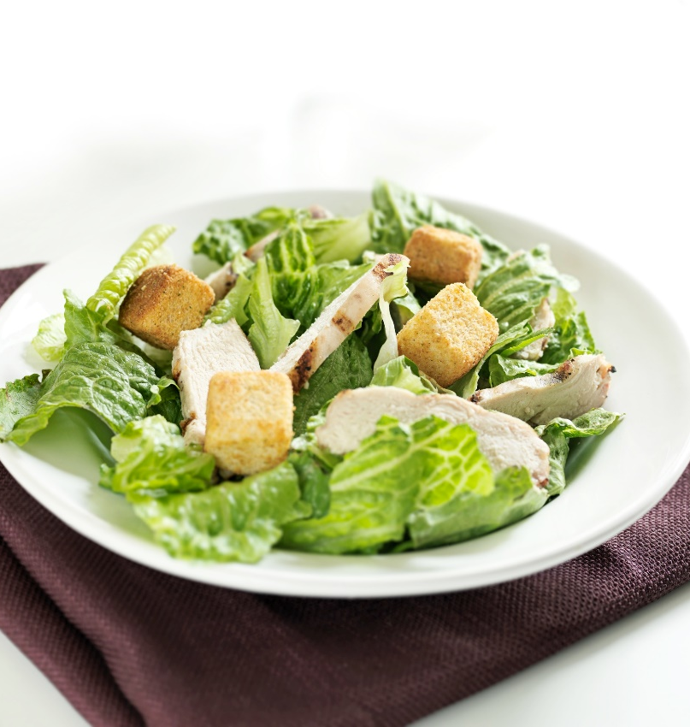
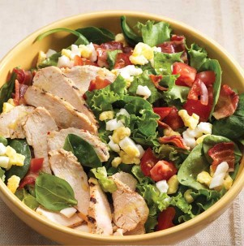

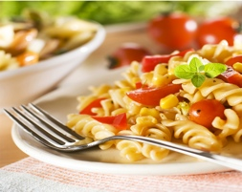
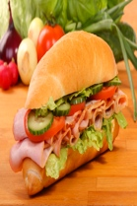
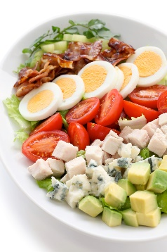

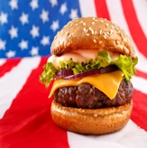
LUNCH BOWLS
Selections
Minimum of 6 Guests. Prices are Per Person
All Served with Grilled Herb Brushed Bread
FAJITA BOWL 9.99
Choose Grilled Chicken or Steak. Loaded with Fresh Avocado, Pico de Gallo, Cheddar Cheese. With Crispy Tortilla Strips, Bell Peppers, Red Onion & a Lime Wedge. Try it with Chipotle Ranch Dressing.
SO – CAL CHICKEN 9.99
Grilled Chicken, Sprouts, Avocado,
Cherry Tomatoes, Cucumber,
Radishes, Roasted Red Peppers &
Feta Cheese
VEGETARIAN DELUXE 8.99
Chickpeas, Tomatoes, Cucumber, Radishes, Broccoli, Carrots, Celery, Bell Peppers, Red Onion, Olives and Button Mushrooms.
PIZZAS
Delivered - 12.99 Pick Up - 11.99
CREATE YOUR OWN
Pepperoni, Sausage, Beef Chicken, Mushrooms, Onions, Black Olives and Tomatoes.
Sliced Cheeses, Lettuce,
VEGETARIAN
Tomatoes, Onions, Grilled Seasonal
Squash, Black Olives and
Green Peppers
MEAT LOVERS
Sweet Italian Sausage, Pepperoni and Ground Beef
SOUTHWESTERN
Grilled Chicken, BBQ Sauce, Cheddar Cheese, Cilantro and Red Onions
. . . . . . . . . . . . . . . . . . . . . . . . . . . . . . . . . . . . . . . . . . . .
SPECIAL MENU IDEAS
Served luncheons or dinners require one wait staff person for every 20 guests. We will be pleased to assist in planning a special meal or function.
www.southernfoodservice.com
ICAFE WEBSITE
www.yokohama.southernfoodservice.com

Slide 2
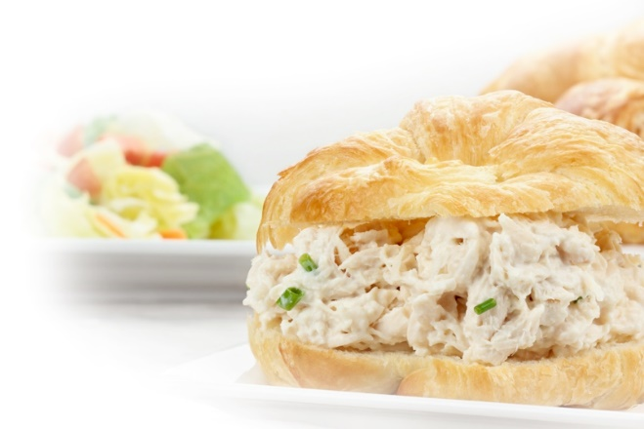

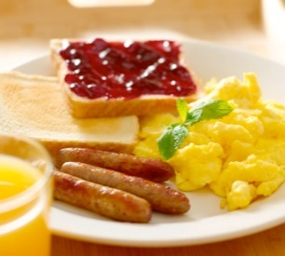

WELCOME
BREAKFAST
Breaks
CONTINENTAL
8.99 per person
Sliced Fresh Seasonal Fruits
Assortment of Bagels, Cream Cheese, Danish, Muffins, Croissants with Butter and Preserves
Freshly Brewed Coffee and Juices
TACO EXPRESS
10.99 per person
Freshly Rolled Breakfast Tacos
Scratch Made Salsa Bar
Country Breakfast Potatoes
Freshly Brewed Coffee and Juices
GOURMET BOX
Lunches
Southern Foodservice Management is pleased to present our catering menu. We offer a delicious array of food and beverage selections designed to meet the needs of faculty and guests. We can provide you and your organization food and service for events as simple as coffee breaks and as elegant as served receptions, luncheons and dinners. This brochure is designed to be used as a guide for planning of events. Although our menu describes a variety of items, you are not limited to selections that are listed. Our Chef Manager will work with you and your organization to tailor and personalize any event to meet your needs. Remember that we provide a variety of catered services such as birthdays, retirements, receptions, anniversaries and holiday receptions.
Each of our box lunches comes
complete with napkin, utensils,
condiments and chips.
The box lunch is perfect for lunch or dinner meetings.
TRADITIONAL BOX 10.89
Contains your choice of a fully dressed Roast Beef, Mesquite Smoked Turkey Breast, Black Forest Ham or Roasted Vegetable sandwich. Served with Cheese on Artisanal Bread. Served with choice of potato salad, pasta salad or fresh fruit salad. Includes a fresh baked Otis Spunkmeyer gourmet cookie.
CROISSANT BOX 10.89
Your choice of freshly made Chunk White Tuna Salad
or Chunky Chicken Salad with leaf lettuce and sliced tomato on a light butter croissant roll. Served with chips, fresh fruit cup and fresh baked gourmet cookie.
LIGHT LUNCHEON
Salads
CHICKEN CAESAR SALAD 10.99
Classic romaine lettuce, crisp sourdough croutons
parmesan cheese and a marinated chicken breast
with Caesar dressing. Served with a fresh baked garlic bread stick and Otis Spunkmeyer cookie.
SOUTHERN FRIED CHICKEN RANCH SALAD 10.99
Fresh salad greens, topped with crispy golden brown
Chicken tenders, tomatoes, cucumbers and Cheddar Cheese. With a house baked bread stick and cookie.
COBB SALAD 10.99
Crisp salad greens topped with diced grilled chicken breast, shredded cheddar cheese, black olives, diced hard-boiled egg, fresh bacon bits and tomato. Served with Blue Cheese Dressing, a bread stick and cookie.
A LA CARTE
Prices Per Person
Assorted Large Bagels 1.89
Assorted Large Danish 1.89
Fresh Baked Muffins 1.99
House Baked Scones 1.89
Stuffed Biscuit Sandwich 2.29
Fresh Fruit Cups 2.99
ASSORTED BEVERAGES
Bottled Juices (10 oz) 2.09
Spring Water Service 1.69 pp
Vitamin Waters 2.00
Tazo Hot Tea 1.59
Starbucks Coffee 12.49
(airpot serves 10)
PLANNING AND
ORDERING INFORMATION
ORDERING PROCEDURES:
We request that catering requests be made a minimum of 48 hours in advance. Catering orders placed 48 hours in advance will allow us to plan for and provide the best quality of service. As always, we will work with you to find solutions to your last minute needs.
GUARANTEE POLICY:
To professionally prepare for each event, we request that you guarantee the number of guests attending your event at least 24 hours in advance.
Our Chef Manager will follow-up with you upon receipt of your catering request to verify receipt of the request, review menu and dates of service and review for any missing information.
PLEASE CONTACT CHEF MANAGER FOR MANY MORE TYPES OF BOXED OR PLATED LUNCHES
PHONE: (662) 854-4660
EMAIL: jacalyn.jefferson@Southernfoodservice.com

